Slide 1
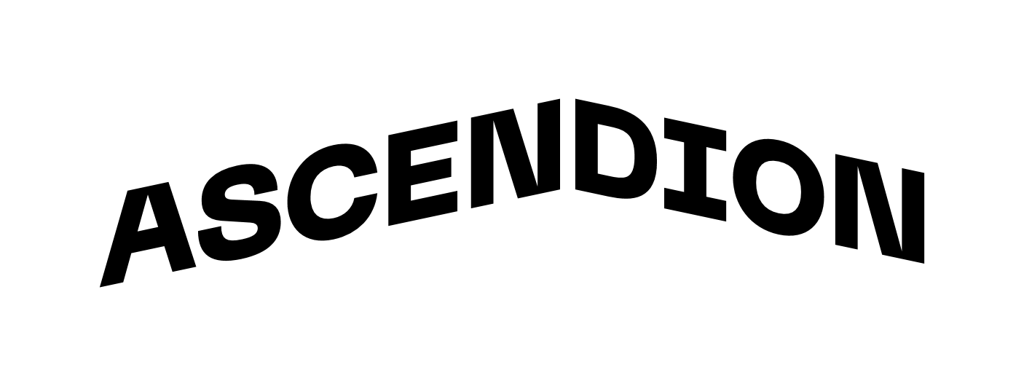
COMMUNICATION BRIDGE FOR WEBSITE DEVELOPMENT TEAM

Slide 2
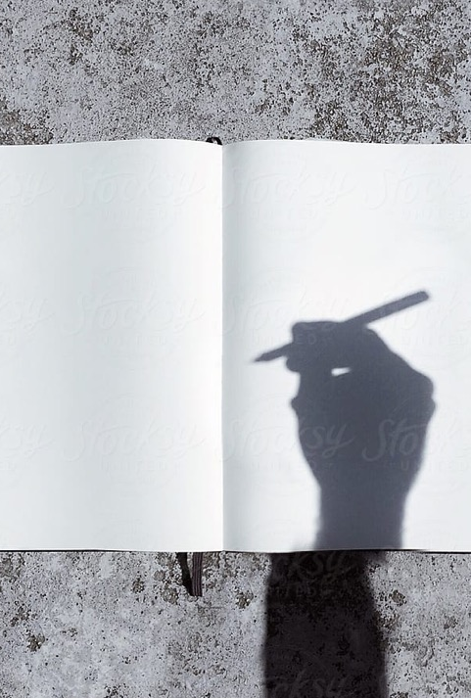


Personal BACKGROUND
(Name, Past Experience, Qualification, Career Summary)
Name :
KADURU SUJITHA
Past Experience :
I worked on an E-Waste Management System using Deep Learning, and I successfully published this project in IEEE Xplore.
Qualification :
B.E CSE- Internet Of Things
Career Summary :
I am passionate about Generative AI, RAG, Automation, AI Agents, and Cloud Technologies.
I focus on building intelligent solutions that combine AI + Cloud to automate complex workflows and deliver efficient, scalable systems.
www.collaberadigital.com

Slide 3
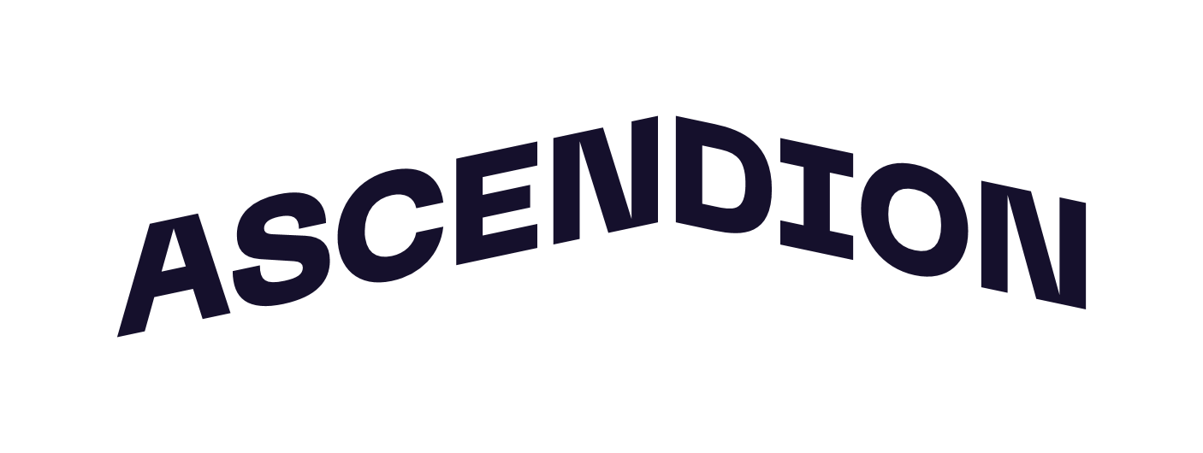

Program Takeaways
Gained practical understanding of end-to-end workflow automation.
Learned how to integrate AI models (Claude 3.5 Sonnet) into real workflows.
Built expertise in using n8n for orchestrating multi-service automation.
Understood cloud architecture with AWS Lambda, API Gateway, and DynamoDB.
Improved skills in JSON processing, API handling, and system design.

Slide 4

Problem Statement
In many organizations, requirements shared after meetings are manually interpreted and forwarded to development teams.
This manual process causes delays, miscommunication, and inconsistent website requirements.
Key challenges:
Meeting transcripts must be manually analyzed
No standard format for sending website instructions
Image and voice-script requirements are collected through repeated back-and-forth communication
No centralized system to track workflow or logs
Goal: To build an AI-powered automation workflow that reads meeting transcripts, generates structured website requirements, communicates them automatically to the website development team, collects asset requests, and sends a clear summary back—while maintaining complete execution logs in AWS.

Slide 5
Current Existing Solution
Today, most teams handle website requirement communication manually:
Meeting transcripts are manually read and interpreted by team members.
Website requirements are typed and formatted manually, causing delays and mistakes.
Image and voice-script needs are collected through multiple back-and-forth emails.
No automated system exists to transfer information between teams.
There is no centralized logging, so it is difficult to track who sent what and when.
Overall, the process is slow, error-prone, and depends heavily on human effort.

Slide 6

Proposed Solution
A fully automated AI-powered communication workflow that replaces all manual effort between teams.
Automatically reading meeting transcripts from Gmail using the Gmail Trigger.
Using AI (AWS Bedrock – Claude 3.5 Sonnet) to analyze transcripts and extract precise website requirements.
Generating a standardized JSON instruction format and sending it to the Website Development Team via Webhook API.
Receiving image and voice-script requirements from the Website Team and converting them into clean, readable text.
Storing all workflow activity (AI output, timestamps, metadata) in AWS DynamoDB for tracking and auditing.

Slide 7
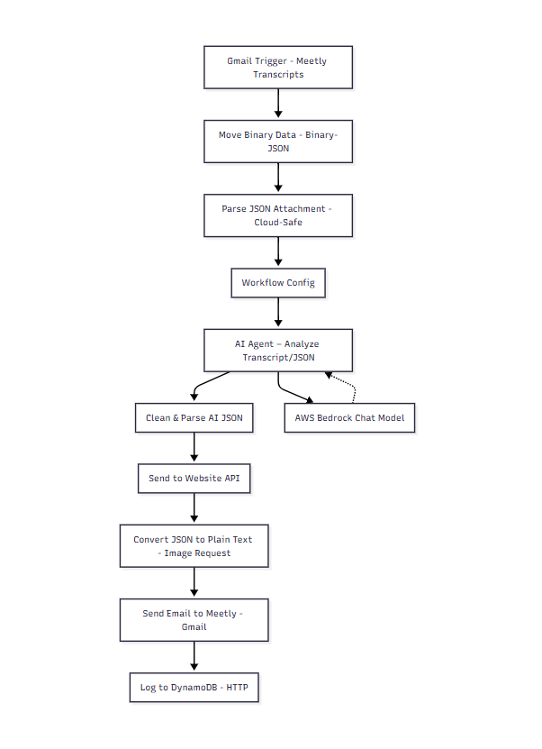
Architecture

Slide 8

Key Features
Automated transcript extraction directly from Gmail using the Gmail API.
AI-driven requirement analysis powered by AWS Bedrock (Claude 3.5 Sonnet).
Standardized, reusable JSON generation for website development.
Automatic communication between teams via Webhook/API integration.
Full workflow execution logs stored securely in AWS DynamoDB through AWS Lambda + API Gateway.
Works for any industry use case (healthcare, education, restaurant, business, etc.).

Slide 9
User Flow
Transcript email is received from the Meetly team via Gmail Trigger.
Workflow extracts and parses the transcript automatically in n8n.
AI analysis is performed using AWS Bedrock (Claude 3.5 Sonnet).
AI output is converted into a structured Website Instruction JSON.
JSON is sent to the Website Development Team API.
Website team returns image and voice script requirements.
Workflow converts them into plain text and sends an email back to the Meetly team.
Every execution is logged in AWS DynamoDB for tracking and auditing.

Slide 10
Tech Stack
Automation & Workflow
n8n – Orchestrates the entire communication workflow
Gmail API – Reads transcripts and sends emails
Artificial Intelligence
AWS Bedrock (Claude 3.5 Sonnet) – AI model used for transcript analysis and structured JSON generation
Backend & Logging
AWS Lambda – Processes and stores logs
AWS API Gateway – Exposes a secure API endpoint for logging
AWS DynamoDB – Stores workflow execution logs for auditing
Scripting & Data Handling
JavaScript & Python – Used inside n8n for parsing, cleaning, and data transformation
Testing & Integration
Webhook.site / n8n Cloud Webhooks – Used for testing API communication between teams

Slide 11
Prototype Preview & Results
Key Achievements:
Automated interpretation of complex transcripts into clean website instructions.
Website API receives structured JSON instantly.
Website Team returns image/script requirements in real time.
Meetly Team receives well-formatted asset request emails.
All execution logs recorded successfully in AWS DynamoDB with timestamps, AI model used, tokens, and raw payloads.
Workflow works for any industry use case (hospital, education, business, restaurant, etc.).

Slide 12
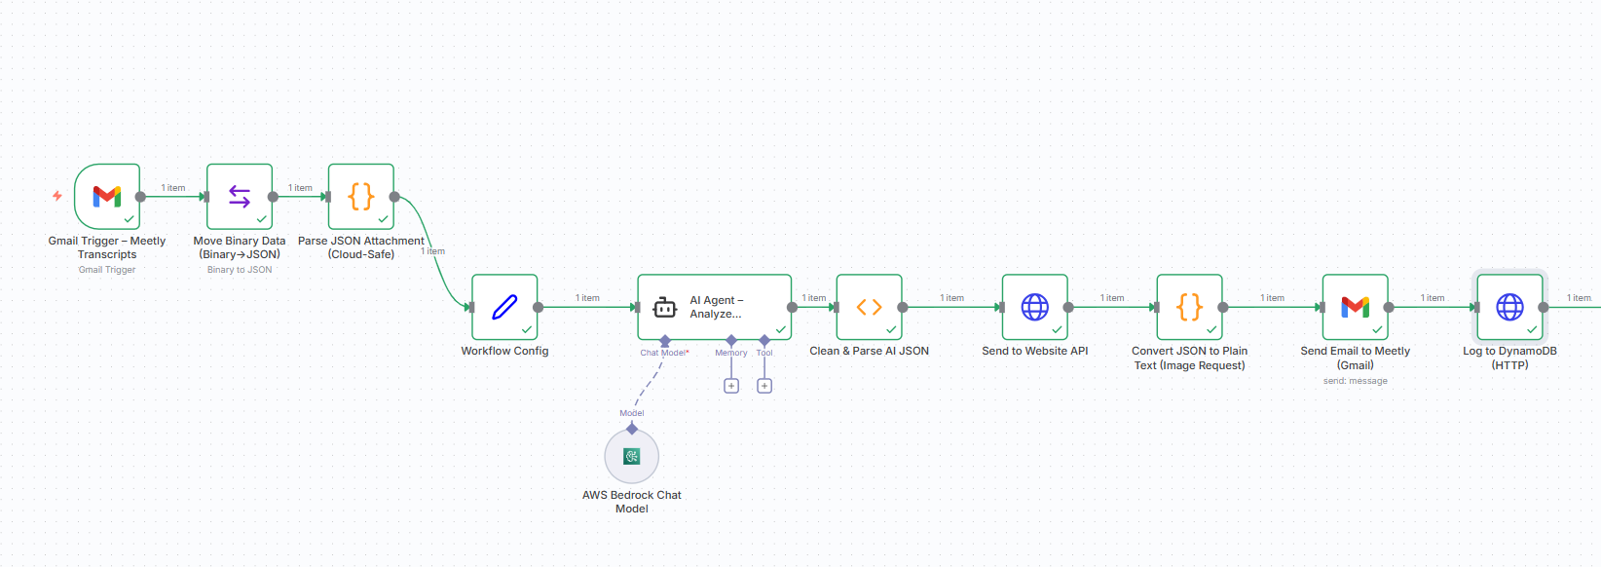
Important areas of the Project with screenshots

Slide 13
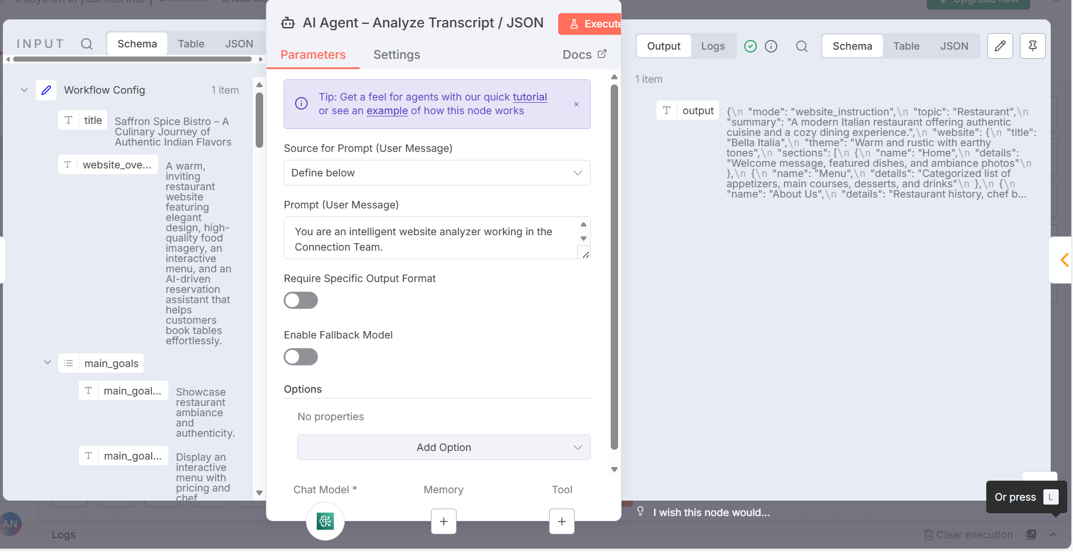
Important areas of the Project with screenshots

Slide 14
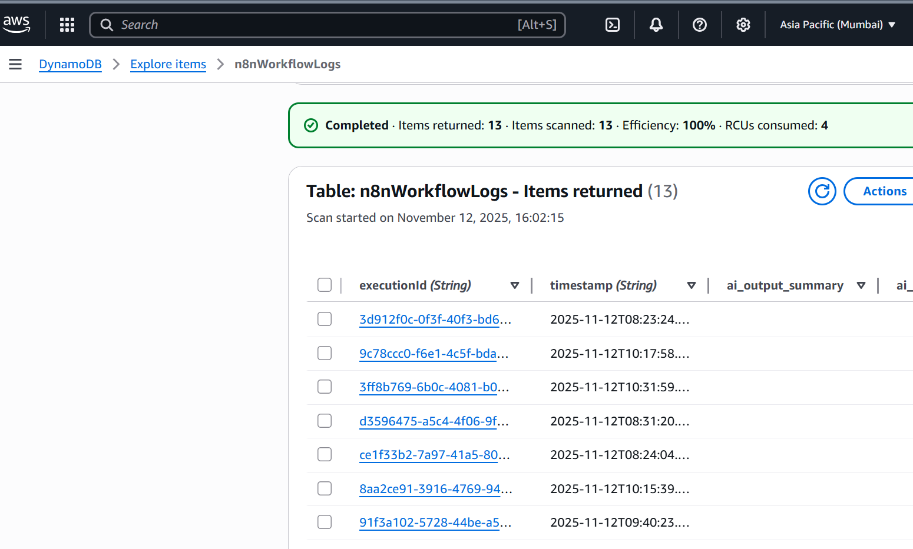
Important areas of the Project with screenshots

Slide 15
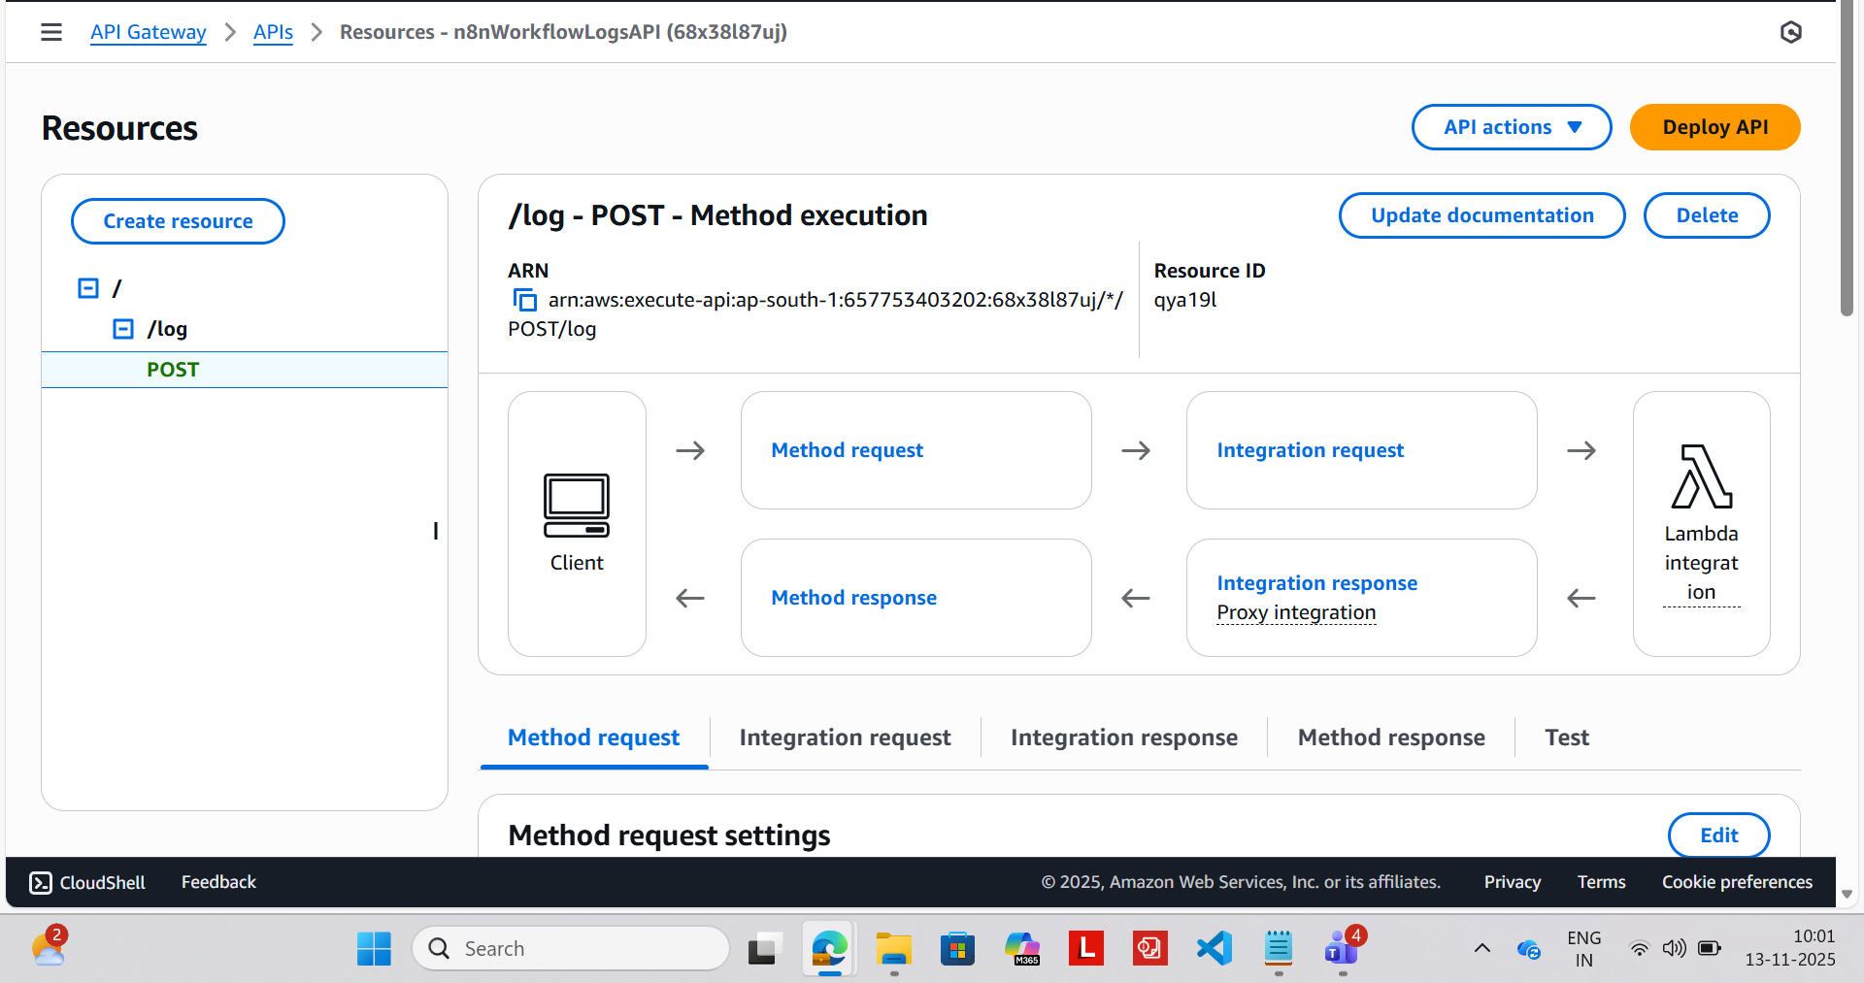
Important areas of the Project with screenshots

Slide 16
Limitations
Workflow depends on the accuracy of transcript content.
Website Team must follow the correct response JSON format.
Requires stable API endpoints for communication.
AWS Bedrock usage has associated cost and token limitations.
Gmail rate limits may impact larger-scale operations.

Slide 17
Future Enhancements or Scope
Add automatic prompt optimization based on historical AI results.
Extend DynamoDB logging for AI token usage cost tracking.
Deploy workflow as Docker container via AWS ECS/ECR for higher scalability.
Add retry mechanism for failed API calls.
Introduce Slack/Microsoft Teams notifications.

Slide 18
Conclusion
This project demonstrates how AI and Cloud workflow automation can transform cross-team communication into a seamless, error-free process.
It highlights the future of AI-driven collaboration, where:
Teams work faster with minimal manual effort
Communication becomes standardized and consistent
Automated workflows ensure accuracy and scalability
The entire process adapts to any domain — healthcare, business, education, or more
This Project is a step toward a world where intelligent workflows handle coordination, and teams focus only on decision-making — not the manual communication in between.

Slide 19
Thank You

